Slide 1












SOCIAL ENTRY
FPIC WORKSHOPS
COMMUNITY TRAINING
RECCE
MEETINGS
SURVEY/
STUDIES/
RESEARCH
FPIC PROCESS
SERIES
OF WORKSHOPS
MUTUALLY AGREED TERMS
NEGOTIATION
SHARING RESULTS
MAP SOCIALISATION
3D and 2D MAPPING

Slide 2

SOCIAL ENTRY
FPIC WORKSHOPS
COMMUNITY TRAINING
RECCE
MEETINGS
SURVEY/
STUDIES/
RESEARCH
FPIC PROCESS
SERIES
OF WORKSHOPS
MUTUALLY AGREED TERMS
NEGOTIATION
SHARING RESULTS
MAP SOCIALISATION
3D and 2D MAPPING

Slide 3

My name is Person A.

Slide 4
I am from Company Y.

Slide 5


GROUND TRUTHING
AREA OF INTEREST/CONCERN

Slide 6


District Administration Structure of Sabah
DISTRICT ADMINISTRATION : SABAH
Sabah Native Affairs Dept
Jab Hal Ehwal Anak Negeri (JHEAS)
Ministry of Local Government and Housing
Kementerian Kerajaan Tempatan dan Perumahan Sabah
District Office/Pejabat Daerah
District Officer/Pegawai Daerah
Native Court
Mahkamah Anak Negeri
Community Development Leaders Unit
Unit Pemimpin Pembangunan Masyarakat
Sub-District Office/Pejabat Daerah Kecil
Assistant District Officer/Penolong Pegawai Daerah
Head of District
Ketua Daerah
Community Development Leader
Pemimpin Pembangunan Masyarakat
Head of Natives
Ketua Anak Negeri
Community Development Officer
Pegawai Kemajuan Masyarakat (CDO)
Head of Natives Representatives
Wakil Ketua Anak Negeri
Township Developer
Pemaju Mukim
Village Development and Security Committee
Jawatankuasa Kemajuan dan Keselamatan Kampung (JKKK)
Village Chief
Ketua Kampung

Slide 7

District Administration Structure of Sarawak
DISTRICT ADMINISTRATION : SABAH
Ministry of Public Health, Housing and Local Govt
Kementerian Kesihatan Awam, Perumahan dan Kerajaan Tempatan
Office of the Premier of Sarawak
Jabatan Premier Sarawak
Chief Secretary of State
Ketua Setiausaha Negeri
Native Court of Appeal
Mahkamah Rayuan Bumiputera
General Administration Unit
Unit Pentadbiran Masyarakat
District Office/Pejabat Daerah
District Officer/Pegawai Daerah
Federal Village Development and Security Committee
Jawatankuasa Pembangunan dan Keselamatan Kampung Persekutuan (JPKKP)
Paramount Chief of Specific Native Groups
Temenggong
Chief of One Native Group
Pemanca
Village Chief/Longhouse Chief
Ketua Kampung/Tuai Rumah
JPKKP falls under the administration of the Federal Ministry of Rural and Regional Development
Regional Head of Several Longhouses
Penghulu

Slide 8
District Administration Structure of
Peninsular Malaysia
DISTRICT ADMINISTRATION : SABAH
Federal Ministry of Rural and Regional Development
Kementerian Kemajuan Desa dan Wilayah
Orang Asli Development Dept Centre
Pusat Jabatan Kemajuan Orang Asli (JAKOA)
District Office/Land and Colony Office (Kelantan)
Pejabat Daerah/Pejabat Tanah dan Jajahan (Kelantan)
Orang Asli Development Department
Jabatan Kemajuan Orang Asli (JAKOA)
Land and Development Affairs
Urusan Tanah dan Pembangunan
Orang Asli Village Development and Security Committee
Jawatankuasa Pembangunan dan Keselamatan Kampung Orang Asli (JPKKOA)
Township Chief
Penghulu Mukim
Village Community
Masyarakat Kampung
JPKKOA falls under the administration of the Federal Ministry of Rural and Regional Development
Village Chief
Ketua Kampung/Tok Batin

Slide 9


VISIT TO RESPONSIBLE GOVERNMENT AGENCY
PEJABAT DAERAH X

Slide 10


VISIT TO COMMUNITY LEADERS
MODE OF ENGAGEMENT
TO BE DETERMINED.

Slide 11




Formal entry in accordance with community’s preferred mode of engagement.

Slide 12
CONSENT OBTAINED – MINUTED AND MINUTES SHARED WITH COMMUNITY

Slide 13

During the formal meeting, company should explain the intention of engagement, what the company intend to do, how the company intends to do it and eventually arrange for an initial meeting with community.

Slide 14
Community to select date and time according to the community’s convenience.

Slide 15
Preferably, get an independent third party to facilitate.
CONSENT OBTAINED – MINUTED AND MINUTES SHARED WITH COMMUNITY

Slide 16

At this meeting, explain ‘who, what, why, when and how’ of the project.
Ask community for their internal decision-making processes.

Slide 17
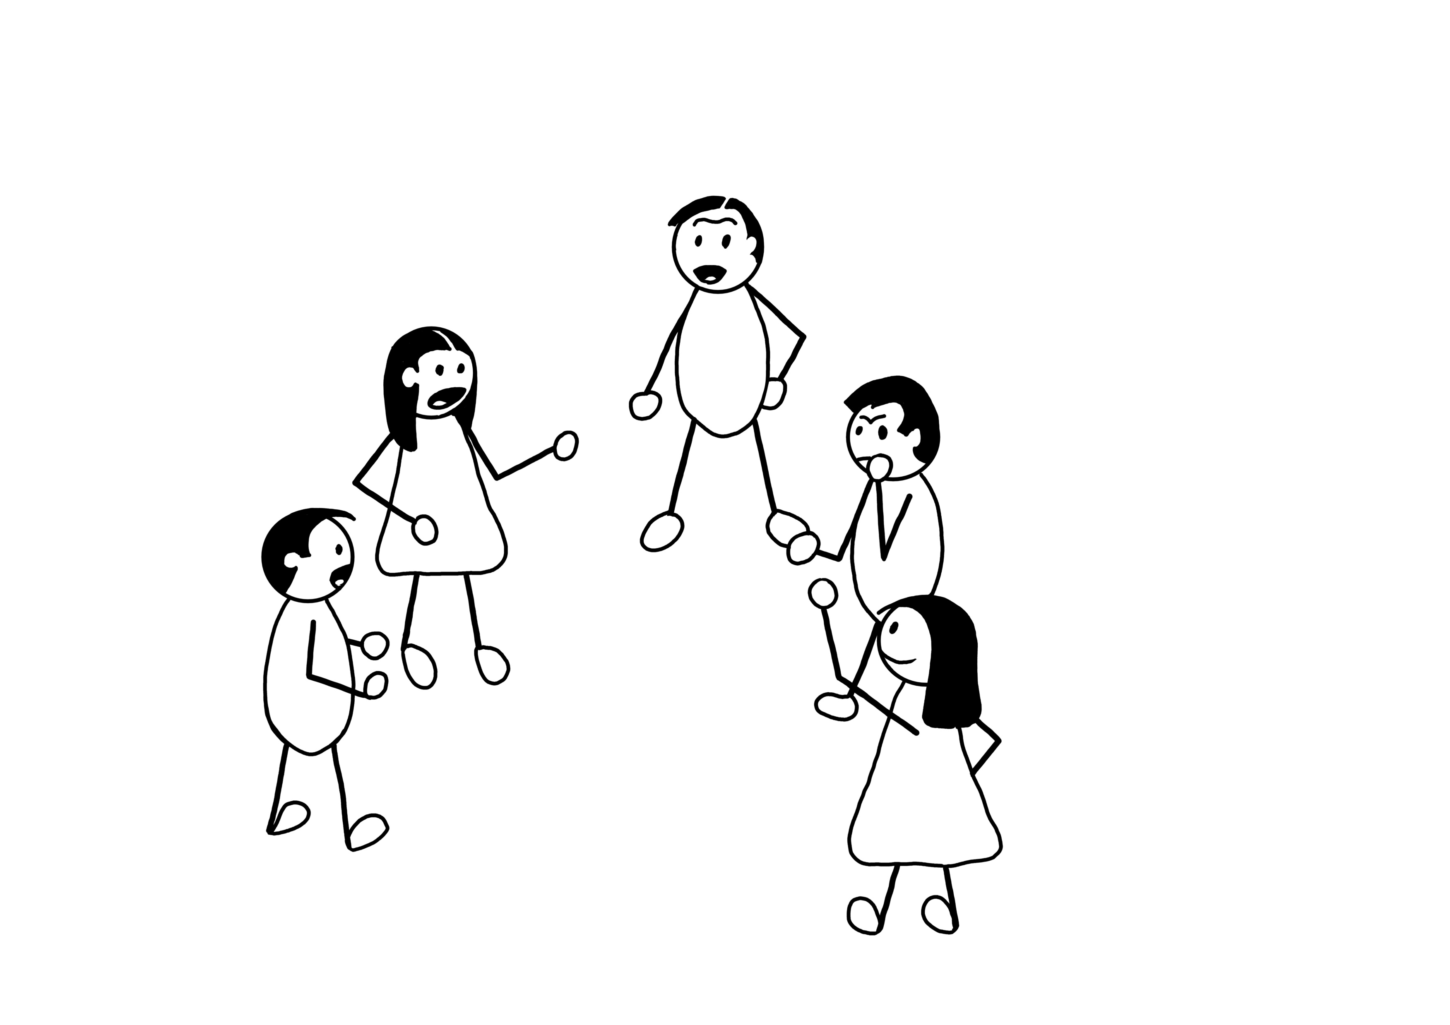
Community to select their own representatives in their own time and space.

Slide 18

Community to select their own representatives in their own time and space.

Slide 19
CONSENT OBTAINED – MINUTED AND MINUTES SHARED WITH COMMUNITY

Slide 20

Independent third party to conduct a series of workshops to ensure FPIC conditions are met and understood.
FPIC
WORKSHOPS

Slide 21
These include representativeness; inclusivity; consensus or community systems.
FPIC
WORKSHOPS

Slide 22

Independent third party needs to explain this to communities.

Slide 23
Independent third party to empower community.
If consent is needed at this point for data collection, it would not be a one-off consent for the Project.

Slide 24
Training Community on FPIC
This process is a reiterative process and will need a few rounds for in-depth understanding.
FPIC

Slide 25


The roles of an independent third party:
Empower community by strengthening organisation skills;
Train community on FPIC processes;
Conduct a social survey if needed;
Codify the internal decision process using FPIC international standards;
Workshop reports for documentation purposes.

Slide 26


Request for a social survey/studies/research.

Slide 27

Once they have consented to a social survey/study/research, understand that this is not consent for FPIC.

Slide 28
Once they have consented to a social survey/study/research, understand that this is not consent for FPIC.

Slide 29

May need to engage with State, do not rely on EIAs or other studies that have been conducted as it may not have been conducted properly.
CONSENT OBTAINED – MINUTED AND MINUTES SHARED WITH COMMUNITY

Slide 30

Surveys/studies to be conducted preferably by an ethical research independent third party and analysed.

Slide 31
To ensure confidentiality and anonymity, personal information of the survey would not be shared with the company.

Slide 32
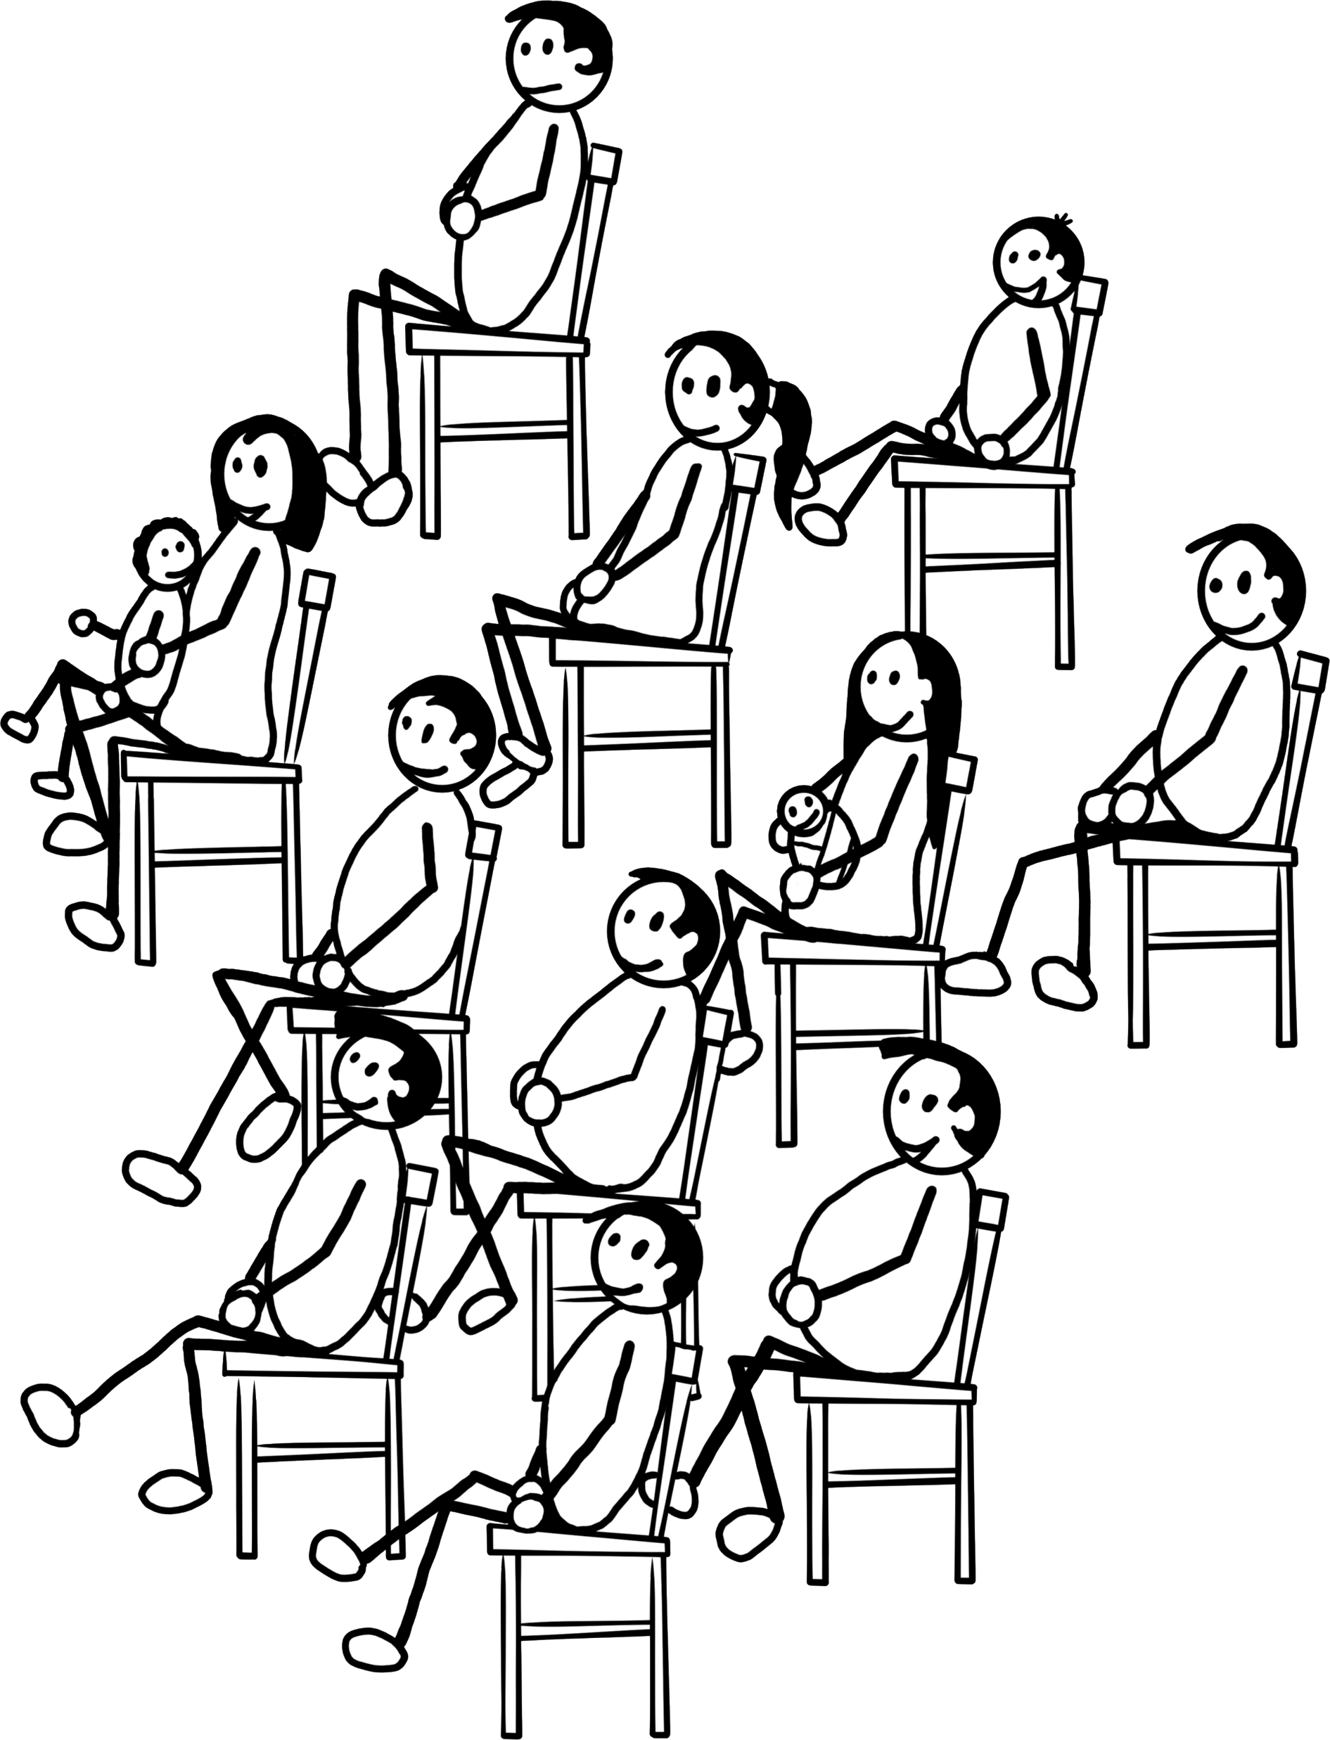
Analysis of data to be shared with community, to local authority and other agencies (if applicable).

Slide 33
HCV
NCR
Others
Series of workshops/meetings will be needed depending on communities’ awareness of social HCVs, NCR and international standards that need to be observed.

Slide 34

Depending on the type of engagement selected, the level of community (i.e. not conflicted, low conflicted, highly conflicted) and the types of process that may be needed, Company Y should step in as observers.
NCR and Rights

Slide 35
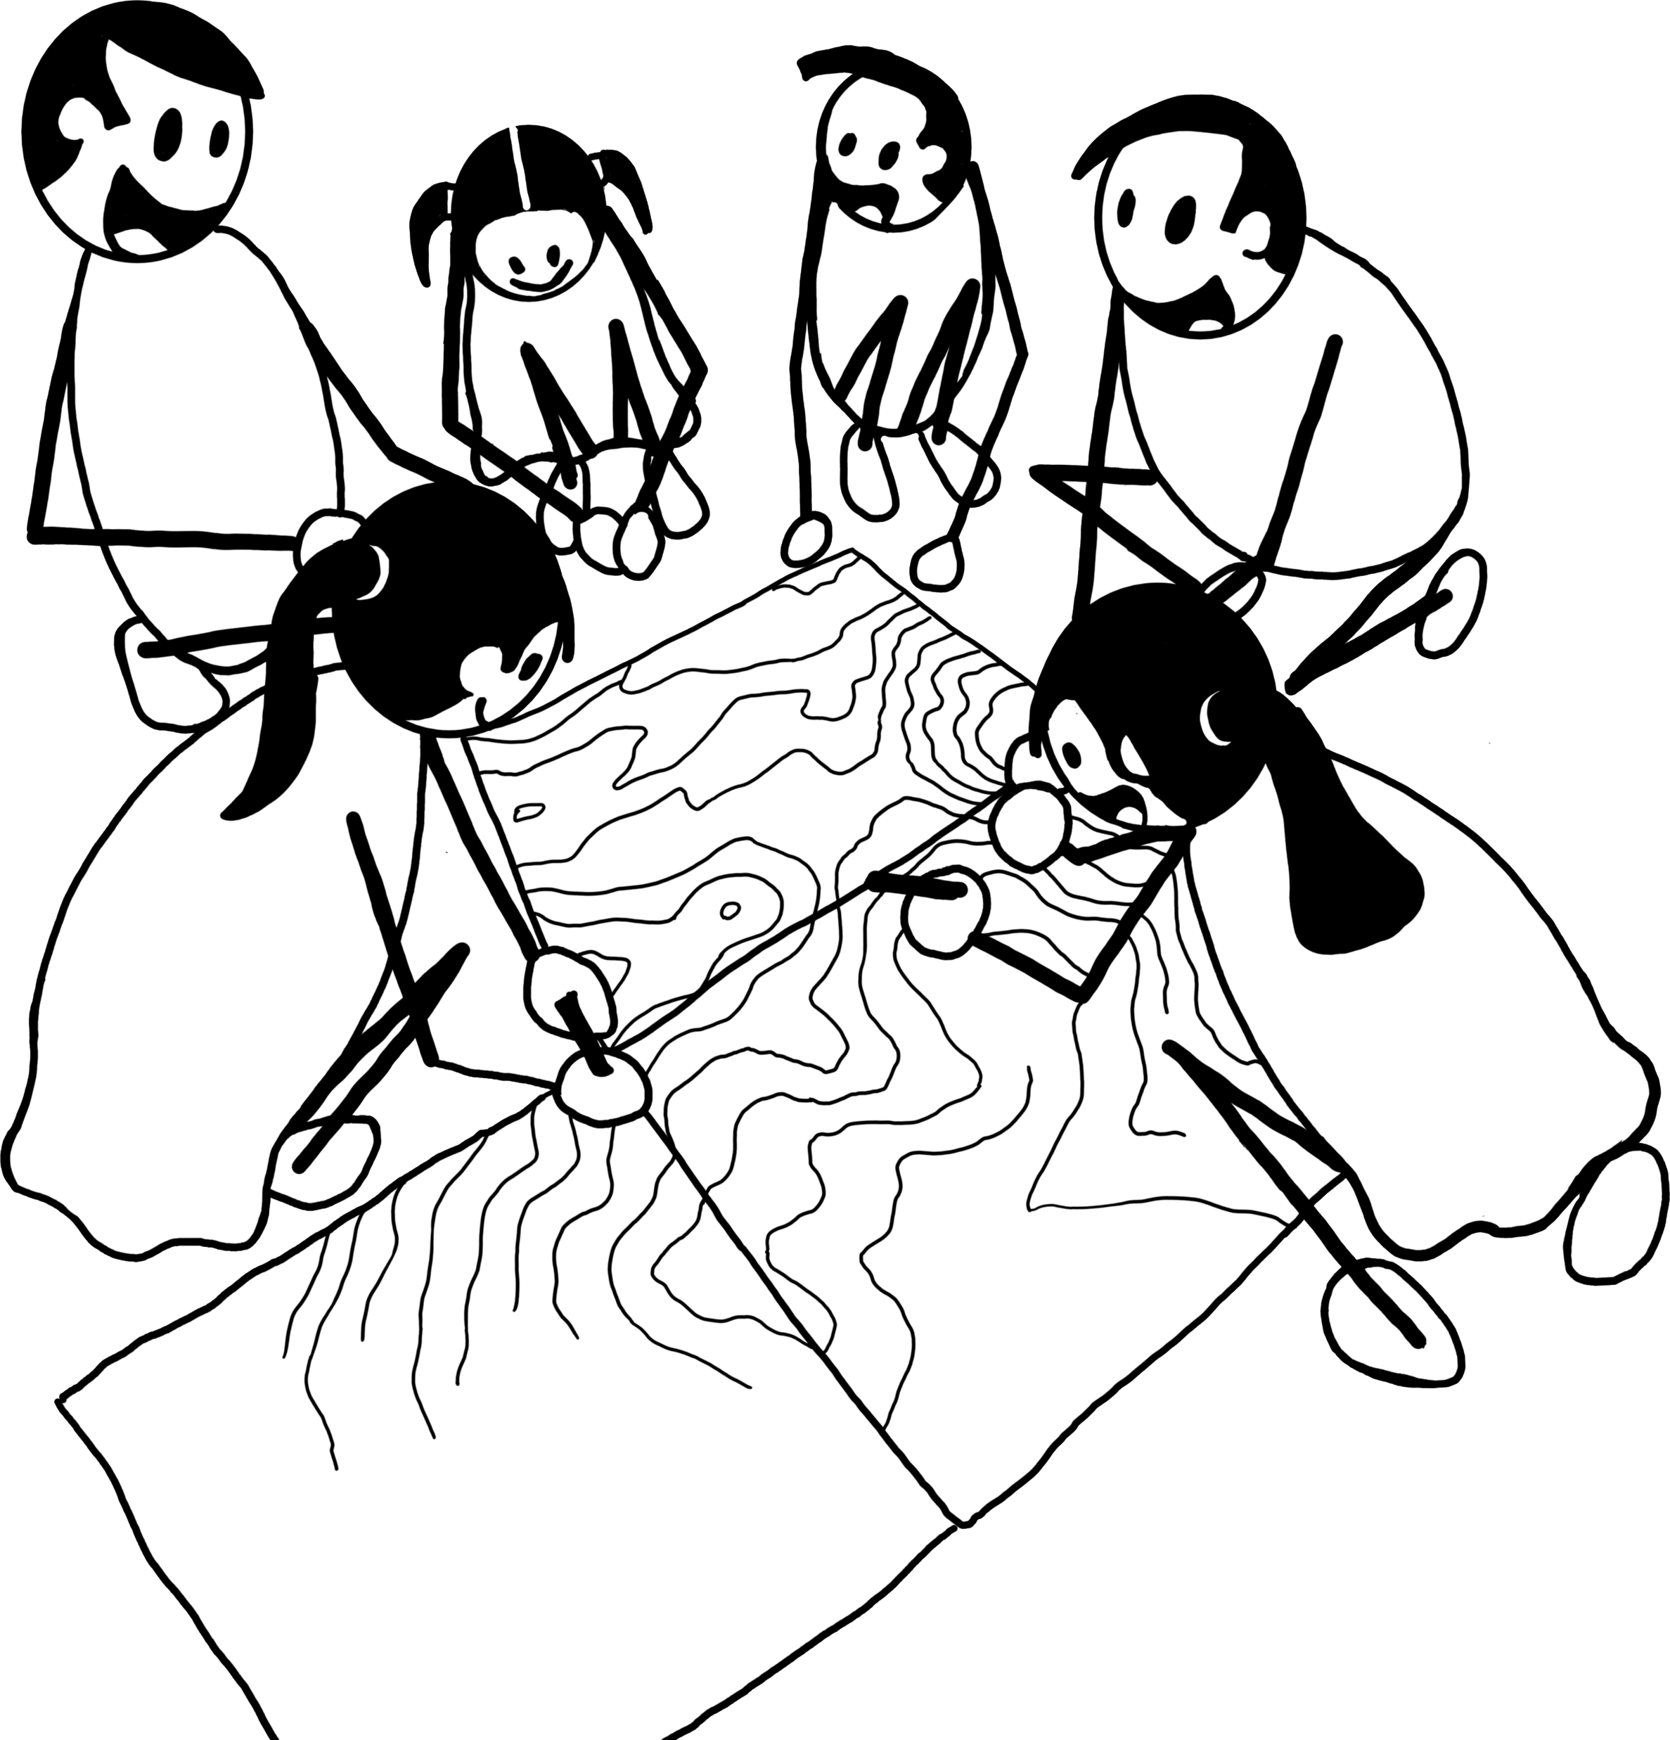
During these workshops, community will start creating the community basemap, PGIS/3D. This may take up to a week or more.
The 2D Map on the other hand could take a whole month or up to 6 months depending on the terrain, size of area and type of community.

Slide 36
The mapping processes may take a few rounds of reiteration and will need socialisation with wider community and neighbouring villages for consensus building.

Slide 37
Independent third party to conduct follow-up workshops, especially on their rights to land or user rights or NCR.
Rights
as a Community

Slide 38
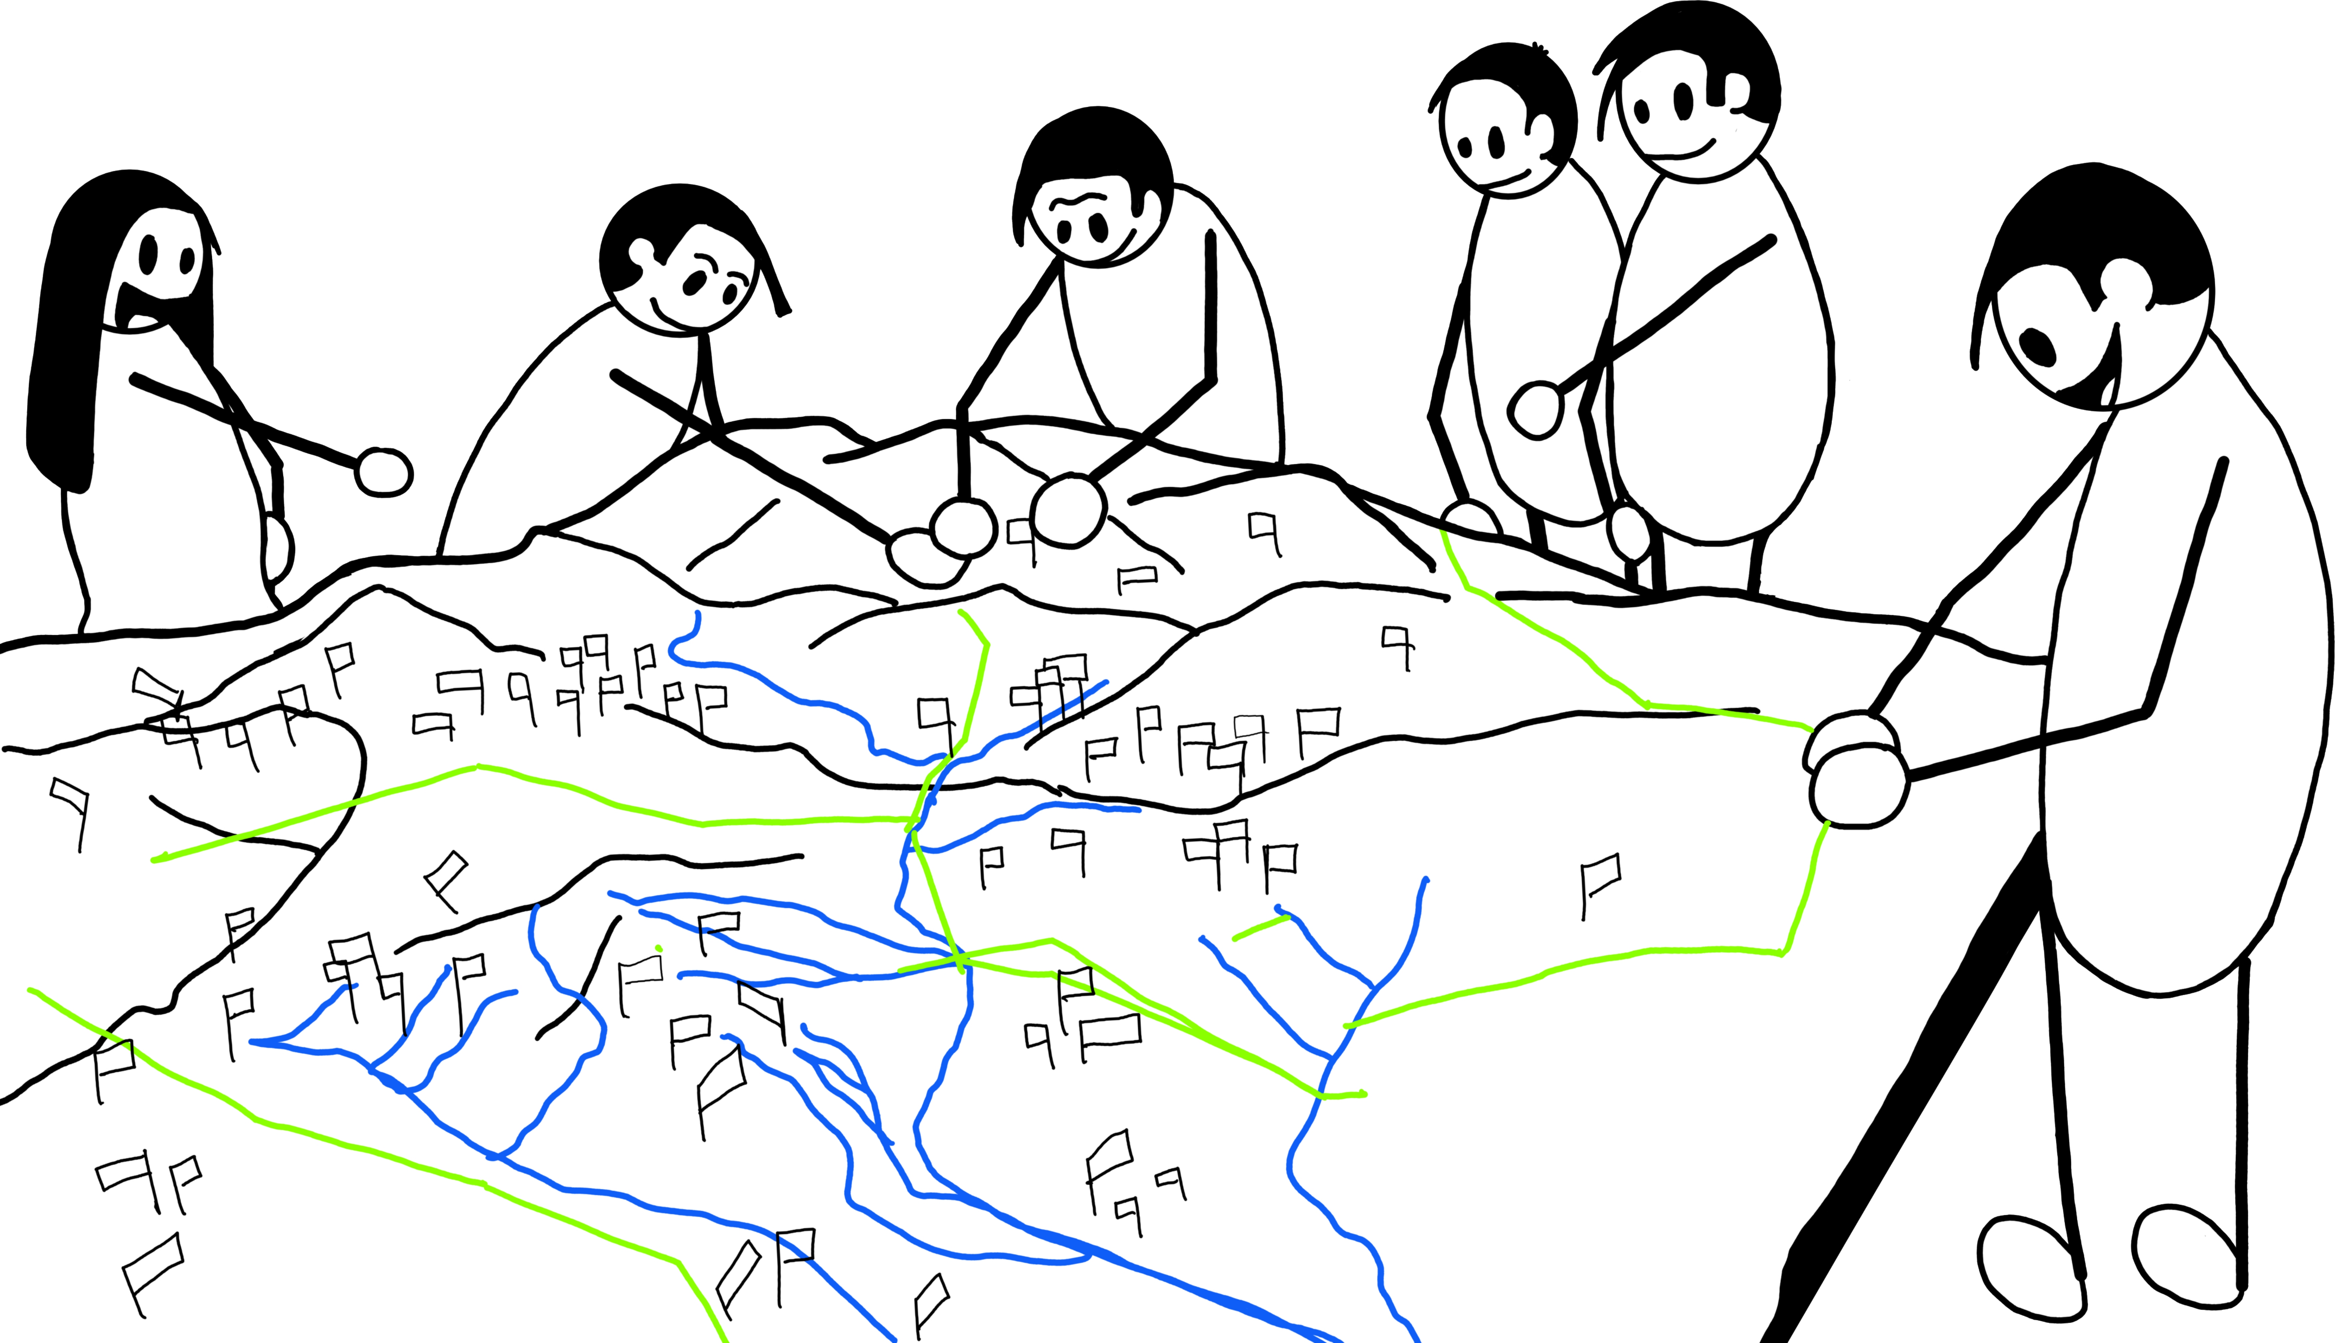
Participatory mapping process – Company not included at this point.
3D Mapping – To help the community put on paper what they need to do to ensure transparency and avoid opportunistic traits on land/resources.

Slide 39
This exercise must be done by the community as a whole and would require the elders to be there to ensure that the traditional boundaries are identified and demarcated.

Slide 40
HCV 4, 5 and 6 will be part of this process.

Slide 41
This will take time and a few rounds of reiteration to be fine tuned.

Slide 42

Company Y steps in as observers.
Socialisation of maps to the larger community may take a few rounds.

Slide 43
Once consensus has been obtained, the external boundaries need to be shared with neighbouring communities.

Slide 44
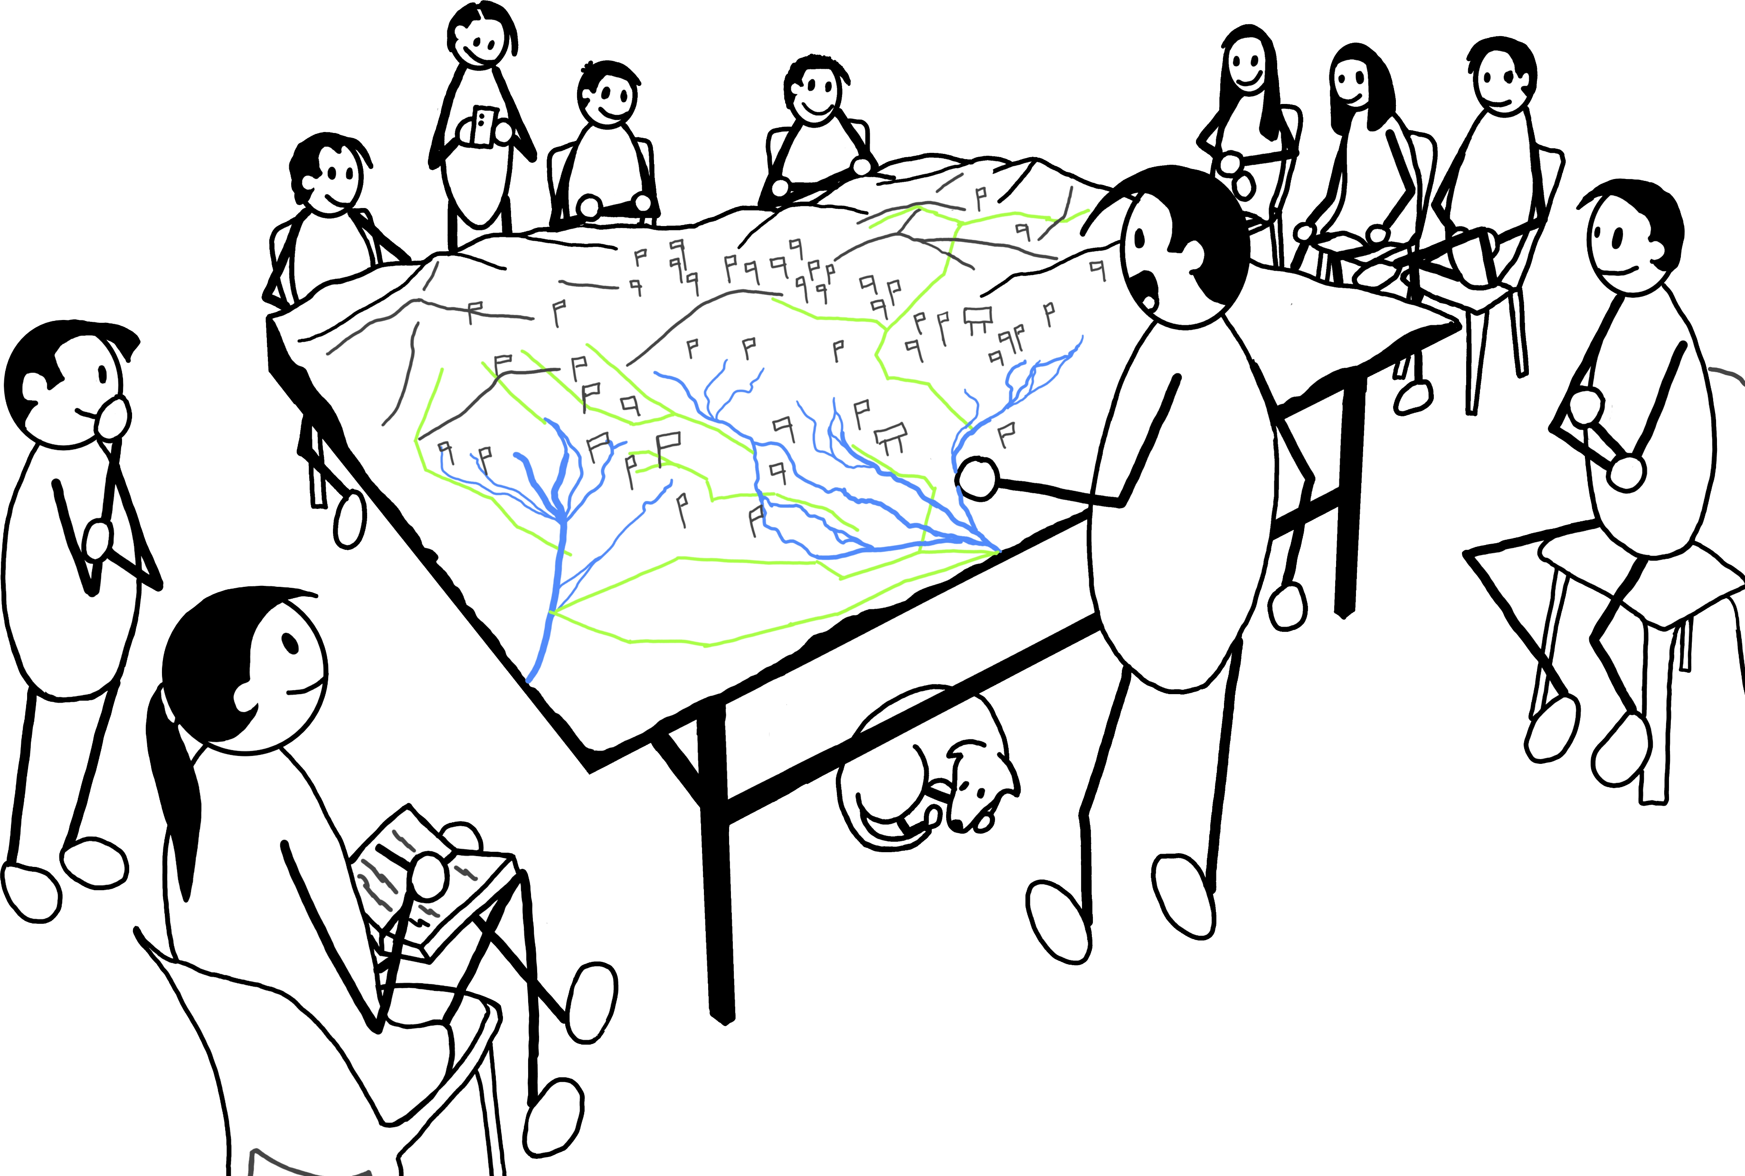
Socialisation of map – Internal boundaries need to be settled internally and agreed upon.
Any internal issues will need to be addressed.

Slide 45
Internal boundaries become important if the Company needs to compensate for the said areas.

Slide 46
Flexible timelines are important during the whole process.

Slide 47

Independent third-party facilitators would be aware of the issues and they should be able to provide solutions.

Slide 48

One final meeting to formalise the maps that were agreed upon.

Slide 49
Consensus on maps.

Slide 50

This process can then lead to the development of a 2D map with the help of the Company.

Slide 51
CONSENT OBTAINED – MINUTED AND MINUTES SHARED WITH COMMUNITY

Slide 52
It needs to be understood that up to this stage, there should be continuous engagement and dialogue between parties.

Slide 53
Consent has not been obtained to participate in the project.
The following steps are necessary in the preparatory process that is needed to avoid future conflicts.
This process also helps build the relationship between the parties.

Slide 54


Sharing results from social surveys, maps, studies, research with communities.
We
If necessary, results are shared with local agencies.
are
Company Y

Slide 55

Reiterate company’s objectives, purpose, scope and hold a discussion on how to proceed.
We
Share company’s plans, studies and other information.
are
Company Y
Company to share Pros and Cons of their project.

Slide 56
This is a crucial step that may need a few rounds of discussion/meetings/dialogue
The community needs to be reminded that they have the right to consent or withhold consent.
No decision to be made at the end of this meeting.

Slide 57
The community should have their own time and space to discuss or to request for further information.

Slide 58
Flexible timelines will be needed. There may be multiple meetings to ensure community understands everything.

Slide 59
Overlap of boundaries between Company and community need to be addressed and/or negotiated.

Slide 60
CONSENT to be obtained from the community and agreed upon by both parties in order to move to the next phase.

Slide 61
NEGOTIATIONS

Slide 62
Rules of engagement should be clarified and agreed upon. The right people should be at the table.

Slide 63
Independent third-party facilitation can help the process.

Slide 64
Once consent is obtained, all parties can proceed to the next phase.
If consent has been withheld, then a repeat of processes or further discussions would be needed.

Slide 65
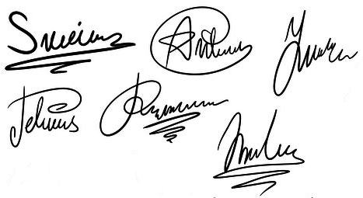
WE AGREE TO PARTICIPATE IN COMPANY Y’S PROJECT
Consent obtained or withheld should be documented.
Community Representative/s

Slide 66
WE DO NOT AGREE TO PARTICIPATE IN COMPANY Y’S PROJECT
Consent obtained or withheld should be documented.
Community Representative/s

Slide 67
Mutually Agreed Terms should be drawn up which would go through a few rounds of discussions and agreement.

Slide 68
This process should include a monitoring component.

Slide 69
A grievance mechanism needs to be developed and shared with the community.

Slide 70

A well-planned FPIC process will benefit both parties in the long run.

Slide 71
Any Questions?

